Slide 1
Case Study
Research Methods

Slide 2
Case Study
Case Study Method
One or few individuals, groups, organizations, or events
In-depth study
Can be used in clinical research to diagnosis and treat
Notes:
Case Study Method
focuses on one or in some cases a few individuals. On occasion, it could also include the study of a single group, organization, or an event.
Researchers are typically not obtaining averages from a group of people or looking a scatterplots to determine if there is a correlation between variables. Instead, researchers conduct an in-depth investigation of a specific person. Researchers intensely observe and record the behavior of a participant in which details are emphasized over generalities. Researchers are seeking to describe the person and their experiences. This observation might span a few months to many years.
This method can be used in clinical research as a way to diagnosis and describe and monitor some form of treatment.

Slide 3
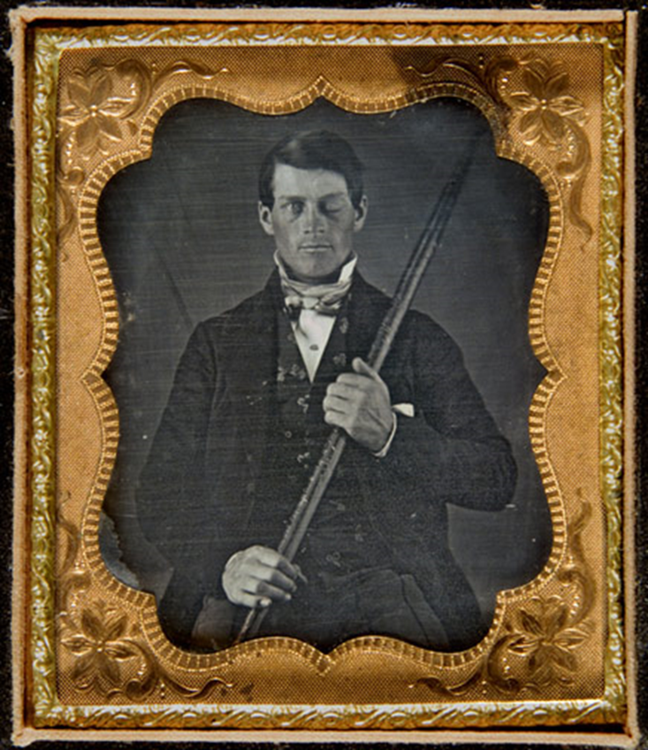
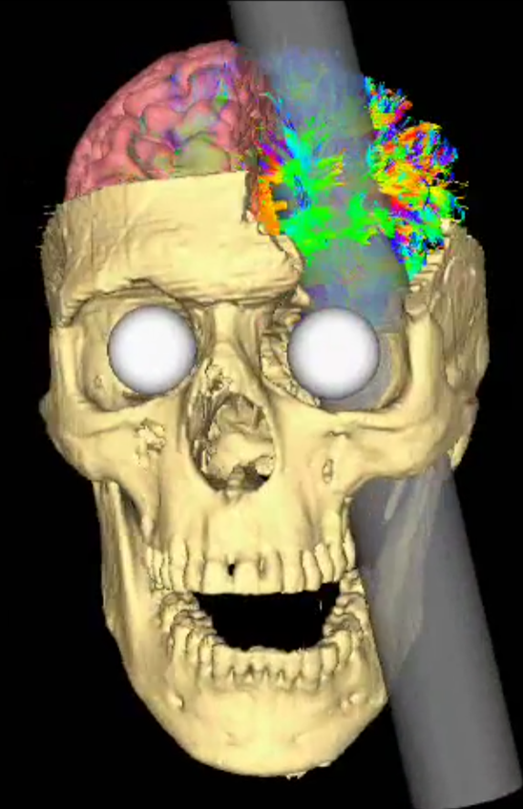
Example
Notes:
Phineas Gage is a great example of a case study that you probably read about in your Introductory Psychology class. Phineas was a railroad worker who survived an explosion in which a rod of iron was driven through is skull. It was a fascinating case because although he maintained functioning his personality changed drastically. This was due, in part, to massage damaged to his frontal lobe. More information about the case can be found via the websites provided below.
http://www.smithsonianmag.com/history/Phineas -gage-neurosciences-most-famous-patient-11390067/
http://www.npr.org/sections/health-shots/2017/05/21/528966102/why-brain-scientists-are-still-obsessed-with-the-curious-case-of-phineas-gage
- Retrieved on May 31, 2017.

Slide 4
Examples
H.M. – patient who experienced anterograde amnesia due to removal of parts of his hippocampus
David Reimer – botched circumcision that was treated through gender reassignment
Genie – raised in isolation without mental stimulation
Notes:
Other examples of famous case studies can be found here…
https://digest.bps.org.uk/2015/11/27/psychologys-10-greatest-case-studies-digested/

Slide 5
Case Study
Helps us to understand unusual/rare phenomena
Good for generating hypotheses or theory
Can show exceptions or that a treatment doesn’t work for some individuals
Notes:
Can be used to help understand unusual phenomena.
Individuals with psychological disorders
Individuals with brain injuries – often used to help determine the mechanisms that are associated with certain functions
Good for generating hypotheses or theory
Research with H.M. helped to better understand how our memory works. Genie’s case contributed to our understanding of how language develops.
Can show exceptions or that a treatment doesn’t work for some individuals.

Slide 6
Case Study
How would you rate the internal/external validity of this method?
Low internal validity
Low external validity
Susceptible to bias
Researcher’s interpretations
Potential for expectancy effects (i.e., experimenter bias)
Selective bias – what is reported or not reported
Notes:
How would you rate the internal and external validity of this method?
Typically, it has low internal validity. This method often lacks control, which makes it difficult to determine how variables are related to one another. Thus, it is difficult to make causal claims.
This method also has poor generalizability. That is, low external validity. One person’s experience isn’t all that representative and may not generalize all that well to other people’s experiences.
Case study designs are also susceptible to bias
The researcher’s interpretations may be biased (unconsciously or consciously).
There are the potential for expectancy effects (i.e., experimenter bias). It is possible that the researcher may influence the client or patient in some way that they may be unaware of.
Selective bias – the researcher makes decisions about what to report or not report. It is possible that they have mountains of data and must make decisions about what themes are emerging or what to report.

Slide 7
Mini-Review
Describe the advantages and disadvantages of the case study?
What are some key characteristics of the case study?

