Slide 1
Ethics and Human Participants
Foundations of Science

Slide 2
Research Ethics
Moral principles applied to research
Ethical responsibility – Who is affected?
Research participants
Scientific community
Society
Initially determined by the researchers themselves
Notes:
When we think about research ethics, broadly we’re discussing the moral principles that are applied to research.
One way to think about ethics, is to think about who is affected?
First, researchers are to ensure the welfare and dignity of participants. The idea is that researchers have a responsibility to all individuals who are part of their research
Second researchers are obliged to ensure the public report are accurate and honest. This is not necessarily an issue of morality, but one that is a concern of proper conduct of researchers. This is what your textbook refers to as treating science ethically.
Both have implications for society. Will the results be misinterpreted? What applied value do they have? How will the knowledge of these findings affect human behavior.
The information in this powerpoint will largely focus on ethical responsibilities to research participants.
Until the end of Word War II, it was up to the individual researchers themselves to determine ethical standards and safeguards for human participants in their research. It was assumed that researchers, bound by their own moral compasses, would protect their participants from harm. However, that wasn’t necessarily true.

Slide 3
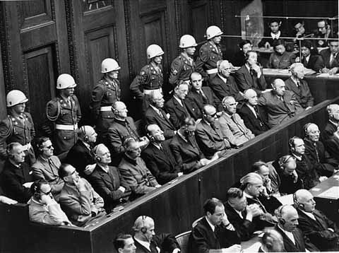
The Need for Ethical Principles
Nazi Germany (1930-1940s)
Twin studies
Sterilization experiments
Hypothermia & High-altitude studies
Physicians tried for war crimes
Nuremberg Code of 1947
Notes:
The events in Nazi Germany, among others, highlighted the need for ethical principles.
The twin studies, sterilization experiments, and hypothermia/high-altitude studies were all examples of research that was conducted without regard for welfare of research participants.
Physicians and researchers who conducted these studies, and others, were eventually tried for war crimes around 1946/1947 as part of the Nuremberg Trials. Twelve of these individuals were sentenced to death, others were given life sentences and some were acquitted.
As a result of the Nuremberg Trial, the Nuremberg Code was developed.
Find more information at https://www.ushmm.org/information/exhibitions/online-exhibitions/special-focus/doctors-trial/nuremberg-code
http://www.jewishvirtuallibrary.org/the-nuremberg-trials

Slide 4
The Need for Ethical Principles
Nuremberg Code
Rules for treating participants
Voluntary agreement
Research must benefit society
Research should be based on previous knowledge
Should not cause mental/physical harm
Don’t conduct if injury/death possible
Risk should be proportional to benefits
Plans & facilities provided to protect participants
Qualified researchers
Participants can stop at anytime w/out penalty
Researchers prepared to discontinue experiment
Notes:
Here you can see the Nuremberg Code:
https://history.nih.gov/research/downloads/nuremberg.pdf
Participation of the subjects must be totally voluntary, and the subjects should have the capacity to give consent to participate. Furthermore, the subjects should be fully informed of the purposes, nature, and duration of the experiment.
The research should yield results that are useful to society and that cannot be obtained in any other way
The research should have a sound footing in animal research and be based on the natural history of the problem under study
Steps should be taken in the research to avoid unnecessary physical or psychological harm to subjects
Research should not be conducted if there is reason to believe that death or disability will occur to the subjects
The risk involved in the research should be proportional to the benefits to be obtained from the results
Proper plans should be made and facilities provided to protect the subject against harm
Research should be conducted by highly qualified scientists only
The subject should have the freedom to withdraw from the experiment at any time if he or she has reached the conclusion that continuing in the experiment is not possible
The researcher must be prepared to discontinue the experiment if it becomes evident to the researcher that continuing the research will be harmful to the subjects
What was the affect on American Research?
No obvious affects
Perhaps American’s thought that such problems would never occur here

Slide 5
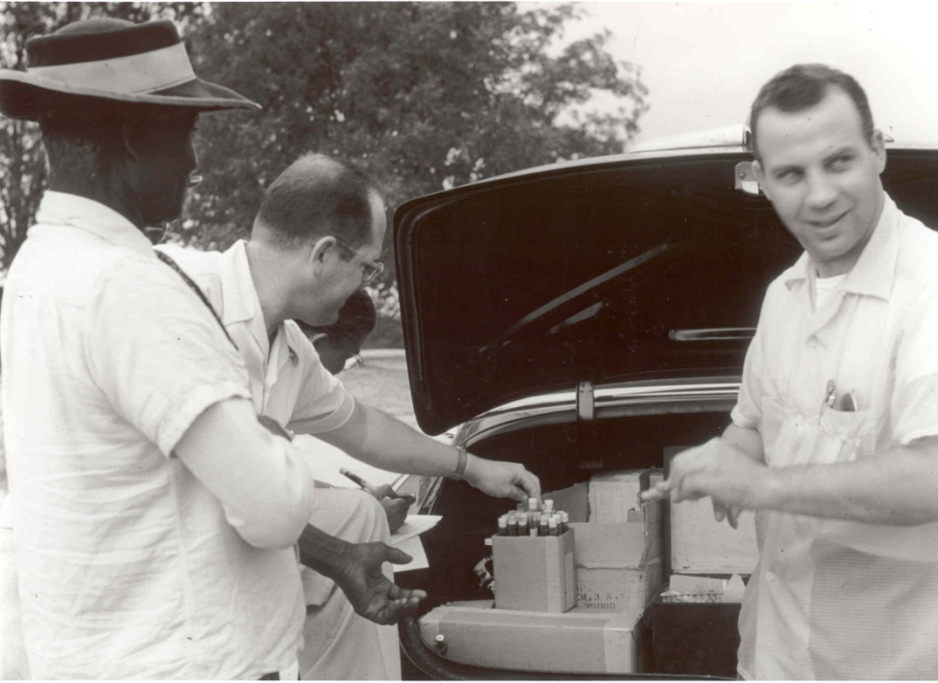
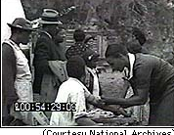
The Need for Ethical Principles
1932: Tuskegee Syphilis Study
U.S. Public Health Service in Alabama
Short-term study to monitor untreated syphilis
Notes:
Another example that illustrates the need for ethical principles is the Tuskegee Syphilis Study.
This study was conducted by the U.S. Public Health Service in Alabama and began as a short-term study to monitor the effects of untreated syphilis.
In 1932, treatments for syphilis were relatively ineffective and had severe side effects.
The intention of the study was in part to measure the prevalence of the disease and to study its natural history.
National Archives - https://research.archives.gov/search?q=Tuskegee%20Syphilis%20Study&highlight=true

Slide 6
The Need for Ethical Principles
Tuskegee Syphilis Study
Vulnerable population
African Americans, rural, low SES, high rates of illiteracy, difficult to obtain medical care
Incentives: burial assistance, medical treatment, hot meals, transportation
What did participation involve?
Periodic health examinations
Not given info (i.e., treated for “bad blood”)
Penicillin withheld (standard cure by 1940s)
Results
Dozens died from syphilis & complications
Many women & children infected
Trust between health community & African
Americans broken
Notes:
However, there were signs from the start that this study has some serious ethical flaws.
First, the population that was selected for the study was highly vulnerable. Participants were black men from the rural south. The population was poor with high rates of illiteracy. This population also found it difficult to obtain medical care.
Second, participants were offered fairly large incentives such as burial assistance, medical treatment (not for syphilis), free hot meals, and free transportation to and from the hospital with a free stop in town on the way home.
What did participation involve?
Periodic health examinations
Men never told what was going on. Instead they were told they were being treated for something called bad blood.
Denial of any kind of treatment for syphilis, even when penicillin (which was the standard cure) was made available.
Nearly 400 men had been left to suffer with syphilis long after a treatment was found, but continued for 40 years just so researchers could examine the final stages of the disease. The results included dozens of deaths from syphilis and complications related to syphilis, women and children were infected, and the trust between the medical health community and African Americans would suffer for years to come.
More information can be found at https://www.cdc.gov/tuskegee/timeline.htm

Slide 7
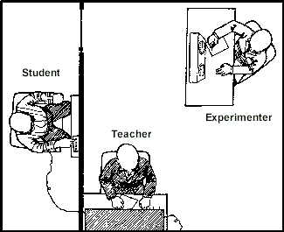
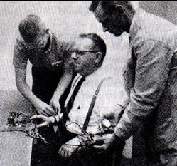
The Need for Ethical Principles
Milgram obedience studies (1960s)
Study concerning the obedience to authority
Notes:
So far, we have only discussed medical ethics in research, but psychologists have not been innocent all this time either. They have had a part to play in the need to establish guidelines and regulations.
A well-known psychological study was conducted by Milgram in the 1960s.
An ad was placed in paper to order to recruit participants. Participants could earn $4.50 for one hour of work in study purported to examine learning and memory.
The setting of the study involved a rather stern looking experimenter in a white lab coat and a friendly co-participant (who was actually a researcher playing the part of a participant – called a confederate).
Participants were told that the study was designed to investigate the role of punishment in learning, and that one participant will be the “teacher” and one will be the “learner.” Although it was set up to look random, participants were always set up to play the role of the teacher and the confederate was always the learner.
The confederate was taken into a separate room and strapped into a chair to prevent movement and an electrode was placed on his arm. The teacher is taken into an adjoining room that contained a shock generator.
The teacher was instructed to read a list of two word pairs and to ask the learner to read them back. If the answer was incorrect, then the teacher was supposed to shock the learner starting at 15 volts. Each time the learner missed a word pair, the teacher was to increase the voltage of the shock.
The generator has 30 switches in 15 volt increments ranging from 15 volts to 450 volts. Each switch also had a label ranging from ‘slight shock’ to ‘danger: severe shock’
If teacher expressed concern or doubt about continuing the experiment, the researcher would indicate that he would take full responsibility for any harmful effects.
What were the results?
65% of teachers punished the learner to the maximum of 450 volts. No participant stopped before reaching 300 volts. It was common for participants (i.e., teachers) to show emotional distress during and after the testing session
There were several ethical issues to consider here – including the role of deception in researcher and the amount of stress experienced by research participants.

Slide 8
Guidelines
Belmont Report (1970s)
Respect for persons
Autonomy
Special protection for certain individuals
Informed volunteers
Beneficence
Protect well-being
Do no harm
Max benefits, min harm
Justice
Share in cost/benefit of research
Participant populations
Notes:
So what became of all this in regards to ethical research?
In 1979, the federal government developed regulations of ethical principals underlying the current regulations and standards that are contained in the Belmont Report. It was the capstone of the National Commission for the Protection of Human Subjects of Biomedical and Behavioral Research. It outlines the ethical principals upon which the ethics of a research study are evaluated in the United States. The Belmont Report embodies the moral consensus upon which stand our present US Federal regulations governing the ethics of human subjects research conduct with Federal funds from the majority of Federal agencies. Our present regulations formulize The Belmont Report's requirements for informed consent and establish another Commission recommendation that formalized and extended the existing peer review system of that time, which has matured into the Institutional Review Board (IRB) system that we have today.
Respect for persons
Research participants must be treated as autonomous individuals capable of making decisions
Persons with diminished capacity deserve special protection
Research participants must be volunteers and be fully informed
Beneficence
The well-being of research participants must be protected
Do no harm to research participants
Maximize benefits of research while minimizing harm to participants
Justice
The researcher and participant share equally in the costs and benefits of research
Precludes using certain populations for research if they will have difficulty refusing participation, and making participation as inclusive as possible
Read more about the Belmont Report here - https://www.hhs.gov/ohrp/regulations-and-policy/belmont-report/index.html

Slide 9
Guidelines
APA Ethics Code
General principles (aspirational)
See section 3.2 of Price textbook
Cost-Benefit Ratio
Institutional Review Board (IRB) approval
Protection of participants’ rights
Categories for review process
Exempt
Minimal risk research (can be expedited)
At-risk research
Notes:
The American Psychological Association (APA) has also developed a code of ethics specifically for psychologists.
1. No harm, 2. privacy & confidentiality, 3. IRB approval, 4. competence, 5. record keeping, 6. informed consent, 7. dispensing with informed consent, 8. offering inducements, 9. deception, 10. debriefing
Psychological research must also be approved via an Institutional Review Board (IRB)
Members typically include faculty/administrators of institution and may include members from the community. The members review new research proposals, but also review annual renewals of existing research projects.
The committee decides whether or not the research proposal is ethical and can be conducted. They evaluate the recruitment of participants, any incentives given, the equipment and materials used, the procedures in place to protect the rights of participants, the procedures in place to handle and store the data, etc.
There are different categories for review process.
Category I (Exempt Review) – presents no possible risk to participants (anonymous, observation of public behaviors)
Category II (Expedited Review) – minimal risks to participants. Proposals may only need to reviewed by the Chair of the committee rather than the full committee.
Category III (Full Review) – this includes at-risk research. The full committee reviews the proposal and the researcher typically attends a meeting to answer questions related to the proposal.
Researchers are given opportunities to address the considers of the IRB.

Slide 10
Ethics in Research
Vulnerable populations
Pregnant women, prisoners, adolescents, etc.
Those not able to give consent
Assent & consent from legal guardian
Precautions in place?
Amount of risk
No risk – consent may be optional depending on the nature of the study
Any risk – consent is mandatory
Notes:
The IRB also requests that researchers identify any participants who may be considered part of a vulnerable population.
Examples of vulnerable populations include pregnant women, prisoners, and adolescents.
They also include individuals who are not able to give consent. Individuals with intellectuals disabilities and children may fail into this category.
In these situations, researchers should obtain assent (i.e., indication from individuals that they are willing to participate in the study) and obtain consent from legal guardians.
The IRB requests information regarding the precautions that are put in place to protect individuals who may be considered part of a vulnerable population.
The amount of risk is also important in determining the precautions needed to be put in place, as well as whether consent is necessary.
If participation poses no risk to participants, then under some conditions consent may not be necessary.
If participation poses any emotional or physical risk, consent is mandatory

Slide 11
Informed Consent
Voluntary Participation
Consent form
General purpose of research
Don’t have to tell participants your hypothesis!
Procedures & participants’ responsibilities
Approximate time commitment
Risk & Benefits
Notes:
Let’s turn our attention to the elements found in informed consent, which is a crucial component to demonstrating respect for persons.
Participation in research must be voluntary.
Informed Consent includes several components.
1. General purpose of research
2. Outline of the procedures and participants’ responsibilities: What is expected of the participants? What type of tasks will they be engaging in? How long will the tasks take to complete?
3. Statements about risks and benefits for participating in the research.
Generally, participants should leave the study no worse than when they entered. This includes information about any potential physical and/or psychological discomfort.

Slide 12
Informed Consent
Privacy/Confidentiality/Protection
Anonymity vs. confidentiality
Inducements/Incentives/Benefits
Rights of participants
Freedom to withdraw
Contact Information
Researcher, IRB
Signatures
Participants & Researchers
Notes:
4. The consent form also includes information about privacy, whether the data will anonymous or confidential, and what protections are in place (e. g., who has access to the data? How will it be stored? If there is a videotape, who will see it? How long will the data be kept).
Anonymity: no identifying information about participant is obtained. Ensures that participants’ responses can never be linked to them.
Confidentiality: identifying information about participant is kept on file, meaning that their responses can be linked back to them. However, this information is never to be given to anybody except the primary investigator of the research.
5. Researchers must clearly describe any inducements, incentives, or benefits. Researchers must demonstrate that participants are free from coercion. That is, they should not offer hefty benefits to try to coerce individuals to participate in potentially risky research (e.g., money, lots of extra credit, job promotion).
6. The consent form also describe the rights of participants. This is a statement indicating that participation is voluntary and that a participant can stop at any time without penalty.
There are power differentials between an experimenter and a participant coupled with the situation make it very difficult for some people to withdraw. Researchers have an obligation to let participants know that it is ok that they withdraw without penalty.
7. Contact information for the researchers, as well as for the IRB is provided.
8. Both the participant and the investigator sign and date the consent form.
Researchers are advised to write consent forms in clear, simple language (not discipline jargon). Participants can ask questions and researchers are obliged to answer them to the best of their ability.

Slide 13
Deception Controversy
Why use deception?
No other way to do some research
Confederates
Issues
Limits subject freedom to choose
Implies subject is untrustworthy
Negative public image & suspicious population
Notes:
Why use deception?
Some research is impossible to conduct without using some degree of deception.
For example, some researchers use placebos (i.e., inert substances or conditions). Other researchers may not explain the true intent of the study. Research investigating topics like sexism or racism may only discuses the purpose of the study in broad generic language. Sometimes cover stories are constructed to conceal the true purpose of the study.
Another example of deception includes the use of confederates. These are researchers who may pose as participants; thus, leading real participants to believe they are interacting with another participant.
Participants do find the research experience valuable even when deception has been used. Only 2% of participants in Milgram’s obedience study later reported being upset. Some researchers suggest that participants rate deceptive research as more important.
However, there are issues that must be considered when using deception.
It limits participants’ freedom to choose. The participant might not have wanted to be part of that research for many different reasons. Without full knowledge of the study it may compromise their ability to make a fully informed decision.
It could send the message to participants that the researcher doesn’t think the participant is trustworthy. That is, the researcher thinks that the participant would lie and is a deceptive person, which is not really the case. Although it is true that participants will sometimes change their response to make themselves look better – deception is used for many other reasons (reasons we just talked about).
Using deception can create a negative image about psychological experiments. I don’t know who many times I’ve conducted experiments and gotten really paranoid participants. People who thought we were trying to trick them. Many times, researchers are using no deception at all or they are just being rather vague about what the purpose of the study is.

Slide 14
Ethics in Research
Debriefing
Return participants to same mental/emotional state
Explain purpose of study
Explain any deception
Repeat confidentiality & anonymity
Get feedback about study
Give ASAP
Notes:
After a study is completed, most researchers debrief their participants. Debriefing usually contains the following elements:
One goal of debriefing is to return participants to the same mental or emotional state.
Typically, researchers explain the purpose of the study using language that is understandable (no jargon)
Researchers explain any deception that occurred in the study. These includes explaining the true purpose of a study if a cover story was used or explaining that participants interacted with a confederate.
It is important to make sue that participants do not leave with false beliefs about themselves
Also, it is important to explain why the deception was necessary (if it was used).
Usually researchers repeat any statements made in the consent form referring to confidentiality or anonymity. Researchers may also explain that the individual participant’s responses will be combined with those of other participants. That is, researchers may be more concerned with the pattern of responses than any one individual’s responses.
Sometimes researchers may get feedback about the experiment. Did participants feel uncomfortable or was something confusing in the study?
It is best to get debriefing as soon as possible. Ideally given at the end of the session, but can wait until the end of the study if is absolutely necessary (this may be the case when collecting data over time).

Slide 15
Mini-Review
What is the difference between confidentially and anonymity?
What are some examples of deception?
What are the key aspects of the Belmont report?
Identify elements that are typically part of a consent form.

