Slide 1
Correct Voice
Active vs. passive
Notes:
In this lecture, you will learn how to use active voice instead of passive voice in APA papers.
For additional instruction on this topic, refer to the Active Passive Voice section of the Grammar module in D2L.
More information and examples are also available here: https://owl.english.purdue.edu/owl/resource/539/02/

Slide 2
Active vs. Passive
Active Voice
Passive Voice
The direct object (the thing the agent does something to) is stated as the subject of the sentence. The verb is stated before the agent.
Discouraged in APA writing.
Example: The book was read by the woman.
The agent is stated before the verb and direct object.
Use active voice in APA writing.
Example: The woman read the book.
Notes:
An agent is the person who is performing the action.
APA writing discourages passive voice. ALWAYS write with an active voice when possible.
In passive voice, the agent can be present or absent.
For example:
→ The meal was prepared by Peggy. (With agent)
The meal was prepared. (Without agent)
Active and Passive Voice (2010) http://www.grammar-worksheets.com

Slide 3
Examples
Active: The students wrote the papers.
Passive: The papers were written by the students.
Active: The weather man predicted rain.
Passive: Rain was predicted by the weather man.
Active: The researcher rejected the null hypothesis.
Passive: The null hypothesis was rejected by the researcher.
Notes:
Instead of writing with passive voice, use active voice in scientific writing.
In many cases, material in passive voice will include the word “by” (e.g., something was done by someone/ something). Often, this phrase is implicit (not written, but implied).

Slide 4
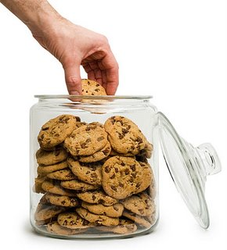
Cookie Example
Active: Someone stole a cookie from the cookie jar.
Passive: A cookie was stolen from the cookie jar (by someone).
Notes:
In passive voice, the agent (someone) was not included. “By someone” is implied.
Not a foolproof method!
Be careful when differentiating between active and passive voice because even when an agent is included, the sentence is not guaranteed to be active.

