Slide 1
Getting Started in APA Style
Terrence D. Jorgensen, Laboratory Coordinator
Adapted by Beth Kirsner, Associate Professor
Psychology Department
Kennesaw State University
Reference material:
American Psychological Association. (2010). Publication manual of the American Psychological Association (6th ed.). Washington, DC: Author.
Notes:
All information can be found within the APA manual

Slide 2
Format Paper Before Beginning
One-inch margins on all sides of all pages (Page Layout → Margins)
Use only Times New Roman 12-pt font in both body and header (Home → Font)
Double-space all text throughout the entire paper
Indent paragraphs using the tab key, which should be set to ½ inch (Home → Paragraph → Indents and Spacing → Indentation → Special = First line by 0.5”)
Only exceptions are:
Abstract is not indented
Reference entries use hanging indentation (Home → Paragraph → Indents and Spacing → Indentation → Special = Hanging by 0.5”)

Slide 3
Remove Excess Space Between Paragraphs
Check for and remove any extra space between paragraphs (typically, new MS Word documents have space after each paragraph by default; see upper image at right)
Go to: Home → Paragraph → Indents and Spacing
Change settings to:
Line Spacing = Double;
Spacing Before and After = 0 pt
Should look like the lower image at right when you’re done
Choose Set As Default to change this to your default for all documents

Slide 4
Spacing After Periods
Periods ONLY at end of sentences should be followed by 2 spaces
Use only 1 space between initials and between elements of a Reference entry (they aren’t sentences)

Slide 5
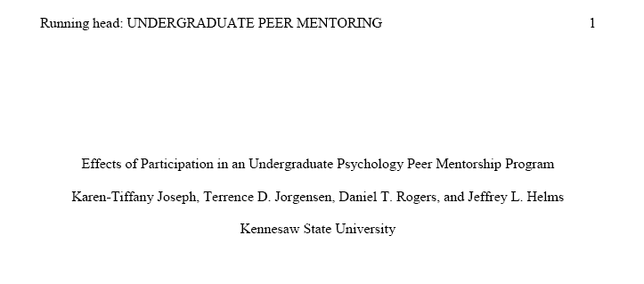
Title Page Components
Running head & Page #
Title
Author’s name and affiliation
Refer to APA pp. 23–24 & see example on p. 41
ONLY the title page has the words “Running head:” preceding the actual abbreviated title

Slide 6
Title Page: Header
Insert → Header → Blank
Check the box that says “Different first page”
At the left margin of the header, type Running head: SHORT HEADER (see next slide for details of the SHORT HEADER)
Tab to reach right margin
Select Page Number → Current Position → Plain Number
Highlight all contents of header and change to Times New Roman font
Notes:
capital R, lowercase h

Slide 7
Title Page: Running head
On the title page ONLY, precede the actual running head with the words “Running head” and a colon and one space
Notes:
capital R, lowercase h

Slide 8
Title Page: Short Title
An abbreviated version of the title that makes sense
Type the abbreviated title in all uppercase letters, flush left
Must not exceed 50 characters, including punctuation and spaces (to get a character count, highlight SHORT HEADER, Review → Word Count → Characters with spaces)
Notes:
capital R, lowercase h

Slide 9
Title Page: Title
Refer to APA pp. 23–24
The title should present the main idea of the paper in 10–12 words
Recommended no more than 12 words
Title should be centered in the upper half of the page
Capitalize major words (see p. 101)
This includes all words that have 4 or more letters, all nouns & verbs
Notes:
Do not place a period at the end of the title

Slide 10
Title Page: Author(s) and Affiliation
Refer to APA pp. 23–24
Type your name(s) on the first line below the title
Center your institutional affiliation (Kennesaw State University) on the next line

Slide 11
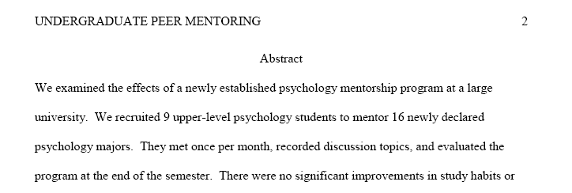
All Other Pages: Header
When you created the header on the title page, you selected “Different first page”
Go to the second page of the document
At the left margin of the header, type the same SHORT HEADER as on the title page
Tab to reach right margin
Select Page Number → Current Position → Plain Number
Highlight all contents of header and change to Times New Roman font
All subsequent pages will have the same header as Page 2
Notes:
capital R, lowercase h

Slide 12
Abstract Format
Refer to APA pp. 25–27
Center the word “Abstract” on the top line of the page
Capitalize only the “A” in “Abstract”
Do not bold this heading
Begin the abstract on the next line, without indenting
Limit word count according to journal’s requirements (usually between 150–250 words; see APA p. 27 & 241)
Highlight text and do a word count

Slide 13
Abstract Content
The abstract is a summary of the paper
See APA p. 26–27 for what to include in Abstracts for different types of papers
Begin with the most important information
Include the results of your study/review
Except at the beginning of a sentence, you may use digits for ALL numbers (APA p. 111 b)

Slide 14
The Body (Text) of the Paper
Center the title on the first line of Page 3
Same title and capitalization as on title page
Do NOT include the word “Introduction”
Do not bold the title
Begin your introduction on the following line
Indent all paragraphs (APA p. 229)
Check your page number at the top right is “3”
Use boldface font for headings within the text (p. 62), which include Method, Results, Discussion, and Conclusion

Slide 15
Citations in Text
Refer to APA pp. 169–179
Whenever you use other authors’ work, ideas, or words, you must give them credit with a proper citation.
Remember that citations do not excuse plagiarism (see APA pp. 15–16)
“Authors do not present the work of another as if it were their own work” (APA p. 16).

Slide 16
Citations in Text: Basic Form
The first time a work is cited in a paragraph, cite the author’s (or authors’) last name(s) and the year of publication (see APA p. 174)
Walker (2000) studied reaction times…
A recent study of reaction times (Walker, 2000)...
A parenthetical citation (Walker, 2000) must include the year each time
A nonparenthetical citation must include the year only the first time per paragraph, unless it could be confused with another citation (APA pp. 174–175, table on p. 177)
There may be multiple sources by the same author(s); see APA p. 178 about identical citations

Slide 17
Citations in Text: Basic Form cont’d
When authors’ names are part of the sentence (try saying your sentence aloud), put only the year in parentheses
When the names are not part of the sentence, cite entirely in parentheses: the name(s), comma, then the year
When citing multiple authors in parentheses, use an ampersand (&) before the last author
The latest results (Enghart & Jones, 2005) show that…
When citing multiple authors in the text, use the word “and”
Enghart and Jones (2005) found…

Slide 18
Citations in Text: Less than 6 Authors
Refer to APA p. 175
When a source has only 2 authors, use both authors’ names in every citation
When a source has 3, 4, or 5 authors, cite each last name ONLY in the first citation of the entire paper (excluding the Abstract)
In subsequent citations, use the first author’s name, but shorten the remaining authors to “et al.”
In Roberts, Baldwin, and Yi’s (1972) classic study, …
Same paragraph: Roberts et al.’s results indicated a correlation between age and intelligence.
New paragraph: Roberts et al. (1972) found that …

Slide 19
Citations in Text: 6 or more Authors
When a source has 6 or more authors, shorten each citation (including first one in paper) with the first author’s last name and all remaining names shortened to “et al.”
In the Reference page, list all names for up to 7 authors
For more than 7 authors, list the first 6 names, insert ellipses (3 periods), then list the final author’s name
Refer to APA p. 184
See example # 2 on APA p. 198

Slide 20
Citations in Text: Direct Quotations
Refer to APA pp. 170–174
Citation of page numbers is only required when you are using a direct quote (APA p. 170)
The “results indicated a strong correlation” (Lopez, 2004, p. 476) in the negative direction.
Page numbers are still strongly encouraged for citations that are paraphrases (APA p. 171) to help your readers find the info
For quotations of 40 or more words, use block quotations (see APA p. 171 & example on p. 92)
Block paragraph, extra indentation, no quotation marks
Citation and page number at end of block
If no page number is available (e.g., a webpage or HTML version of journal article), use the section heading and either paragraph symbol or the abbreviation “para.”
Click Insert → Symbol, click the Special Characters tab, and find the ¶ symbol
See examples on APA p. 172

Slide 21
Citation of Secondary Sources
Refer to APA p. 178
When you wish to use information that the author of a paper has cited, it is best to obtain the original (primary) source.
If this is impossible, cite by listing the author(s) and date of the primary source, followed by the author(s) and date of the secondary source (i.e., the one you read).
This confirmed the results (Chen, 1990, as cited in Izerman, 2001).
Chen (1990, as cited in Izerman, 2001) found that…
Refer to APA pp. 175–179 for information on how to cite groups/institutions as authors, works with no author, personal communications, and many other exceptions and special circumstances

Slide 22
Expectations
Many of your professors will expect you to avoid using quotes and to avoid using secondary source citations. If you don’t know your professor’s policy, ask.
Papers written in APA style rarely contain any quotes
Ideas that come from others are almost exclusively conveyed by paraphrasing
Papers written in APA style rarely contain secondary source citations.
Only under rare circumstances will it be impossible to obtain the primary source cited in an article you read (if you have enough time to wait for InterLibrary Loan)
Unless it isn’t possible, you should always read the original source of the information you want to use

Slide 23
Primary Source Material
When you read an empirical article, there are several sections in which you might find information you will want to incorporate into your papers.
The introduction contains mostly information that comes from (and is credited to) other primary sources. As such, you should generally not be using the material found in the introduction of an empirical article as support for the statements you make in your own paper. Instead, you when you locate ideas in the introduction that you would like to use to support your own argument, you should obtain the original source cited in the introduction to that paper. Then you should read that paper and cite it directly if it does indeed provide the support you need.
Information found in the results section of an empirical article is what you should typically be reporting in support of your argument because this information is specific to the article in which you find it. You should be reporting the outcome(s) of the studies you read (though typically not the statistical results).
Information found in the discussion section may also be appropriate to use to support your argument, particularly if your argument will be supported by the authors’ interpretation of the results.

Slide 24
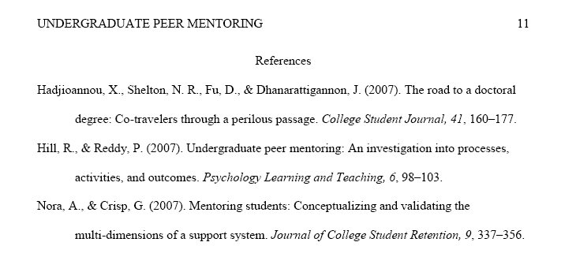
Reference Page Format
Center the word “References” at the top of the page
Use Control + Enter to start at the top of a new page
Begin your first entry on the next line, including a hanging indentation for subsequent lines
Home → Paragraph → Indents and Spacing → Special → Hanging by 0.5”
References should appear in alphabetical order by the first author’s last name (see details on APA pp. 181–182)

Slide 25
Reference Page Content Author(s) Names
Begin by listing up to 7 authors’ last names and initials in the order they appear on the article
Saywitz, K. J., Mannarino, A. P., Berliner, L., & Cohen, J. A.
Alphabetize “nothing” before “something”
Saywitz, K. J. goes before Saywitz, K. J., et al.
If there are more than 7 authors, list the first 6 authors, then ellipses (…), then the last author
Saywitz, K. J., Mannarino, A. P., Berliner, L., Cohen, J. A.,
Smith, K., Dietrich, L.,…Jordan, K. F.
Include space between each initial (or hyphen if name is hyphenated; see APA p. 184)
See APA pp. 181–182 about alphabetizing surname prefixes (Mc/Mac, O’, de, von/van, ben, ibn)

Slide 26
Reference Page Content: Journal Articles Date & Title
Follow the last author name with the year of publication, in parentheses, followed by a period
Robertson, L. A. (2004).
If a magazine, newsletter, or newspaper is published monthly or more often, it requires the month and sometimes the full date, accordingly (see APA p. 185)
Type (n.d.) to indicate that there is no date available
Next, type the article title, capitalizing only the first word of the title and subtitle and any proper nouns
Place a period at the end of the title (APA p. 186)
Do not italicize the title or use quotation marks
Robertson, L. A. (2004). Treatment for clinically depressed adults: A new approach.
Notes:
No extra space between elements of a reference entry as there are between sentences.

Slide 27
Reference Page Content: Journal Articles
Publication Information
After the article title, enter the journal name and volume number in italics, both followed by commas.
Conclude with page numbers of the article (not italicized) and a period.
Use an En dash between pages (see APA p. 97).
In Word, hold Ctrl and type the minus sign on the number keypad.
If no keypad, Insert → Symbol → Special Characters
Robertson, L. A. (2004). Treatment for clinically depressed adults: A
new approach. Psychological Bulletin, 122, 125–143.
If the journal requires an issue number (see APA p. 186, examples on pp. 199–200), place it immediately after the volume number in parentheses, not in italics.
Klimoski, R., & Palmer, S. (1993). The ADA and the hiring process
in organizations. Consulting Psychology Journal: Practice and
Research, 45(2), 10–36.

Slide 28
Reference Page Content: Books Title and Publication Information
Enter the authors’ names and date of publishing, same as for journal articles.
Follow the publication year with the book title in italics (with unitalicized edition in parentheses if applicable), ending with a period (see APA p. 185)
Same capitalization rules as article title, not journal title
Rules are consistent according to periodical status
Follow the title with the location of publication and the publisher, closing with a period (APA pp. 186–187)
Beck, C. A. J., & Sales, B. D. (2001). Family mediation: Facts,
myths, and future prospects (2nd ed.). Washington, DC: American Psychological Association.

Slide 29
Reference Page: Other Types of Sources
There are several other types of sources. For information on how to construct reference entries for other types of sources, see APA pp. 205–215
Technical reports, abstracts, conference papers/posters, theses and dissertations, reviews, audio and video, blogs, raw data and software,…
Details about legal material as sources on pp. 216–224
Electronic sources on APA pp. 187–192
Additional detailed instructions for electronic sources can be found at Purdue University’s webpage:
http://owl.english.purdue.edu/owl/resource/560/10/

Slide 30
Numbers
Refer to APA pp. 111–114 for full details
ALWAYS spell out any number that begins a sentence
In general, spell out numbers under 10; use numerals for numbers 10 and above (e.g., six pages; 19 pages)
Use numerals for numbers that precede units of measurement (including time), and abbreviate most units (metric preferred; see APA p. 115)
3 cm, 0.8 sec (or 800 ms), 7 years, $2
Use numerals for math functions (e.g., 3%, ratio of 16:1)
Use numerals for all numbers in abstract (except first word of sentence)
Use numerals in a series: Groups 1, 2 and 3; Table 1, Figure 2

Slide 31
Language
Avoid biased language and labels
See APA pp. 71–77 about referring to specific groups (age, gender, race, disabilities, sexual orientation, etc.)
Capitalize names of ethnicities (APA p. 75)
Black or African American is preferred to Negro or Afro-American
Use “people diagnosed with schizophrenia” or “schizophrenic patients” instead of “schizophrenics”
Avoid Anthropomorphism (APA p. 69)
“A study” and “the experiment” are abstract ideas that do not have human qualities
They can “show” or “indicate”
People discuss, interpret, etc.

Slide 32
Use Specific Language
“Since” should only be used to indicate a passage of time, not as a synonym of “because” (see APA p. 84)
Use “while” only to indicate events that occur simultaneously (APA p. 84)
Alternatives are “although” or “whereas”
See APA p. 83 about “that” vs. “which”
Use “who” to refer to humans, not “that” or “which” (APA p. 79)

Slide 33
Grammar & Mechanics
A clause is a phrase with a subject and verb
Independent clauses can be joined by coordinating conjunctions (and, or, but, nor, for, so, yet)
Independent clauses joined by coordinating conjunction always need a comma before the conjunction
Dependent clauses can be joined by subordinating conjunctions (before, after, unless, because, etc.)
Only use a comma to separate a dependent clause when it precedes the independent clause
I failed the test because I forgot to study.
Because I forgot to study, I failed the test.
See APA pp. 87–96 for guidelines on all punctuation usage
Separate every item in a series with a comma (p. 88)

Slide 34
Random Mechanics
Apostrophes ONLY indicate possession and contraction, NOT plural (see APA p. 114)
1990s, not 1990’s
Refer to APA p. 97 about differently sized dashes and hyphens
Regular hyphen (-), En Dash (–), & Em Dash (—) can all be found in Insert → Symbol, Special characters
When to hyphenate: see APA pp. 98–100
Do NOT hyphenate prefixes/suffixes listed on p. 99
(including “non,” “pre,” “post,” and “re”)
Do NOT hyphenate an adverb to the word it modifies (i.e., well known, not well-known)

Slide 35
Psychology Laboratory Social Science Room SO 4026
Help for specific questions is available by appointment or walk-in basis
Tutoring in statistics and SPSS
Library/internet research assistance available
Library of textbooks, SPSS guides and APA Manuals available for use in Psych Lab
Schedule appointments in person or by contacting the Lab Coordinator
470-578-2226
Hours and other resources posted on the webpage:
http://psychology.hss.kennesaw.edu/resources/psychlab/

